Slide 1

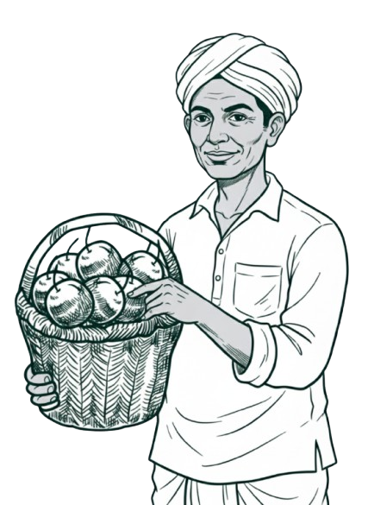




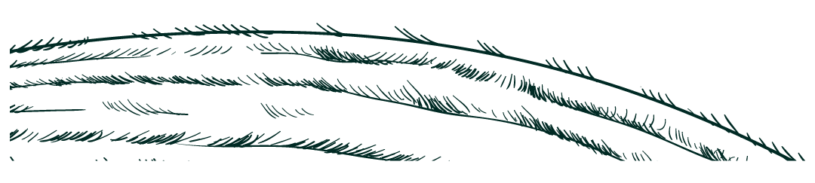
nEXsOIL
Grow smarter with tech!

Slide 2


INTRODUCTION
Our project introduces a smart agricultural rover designed to assist farmers in monitoring soil and environmental conditions. The rover autonomously moves across farm fields, collecting data on soil quality, temperature, air humidity, and visuals using various sensors — including a soil moisture sensor and a camera module.
Equipped with an ESP32 microcontroller, the rover transmits this information to a web server, which is linked to a Flutter-based mobile application. The app provides real-time data visualization and allows users to control the rover’s movement remotely, making field monitoring easier and more efficient.
This integration of hardware and software helps bridge the gap between traditional farming and modern smart agriculture.

Slide 3
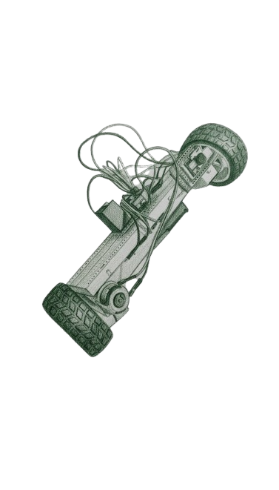
key components
01
ROVER
02
MOBILE APPLICATION
03
Prototyping landscape

Slide 4





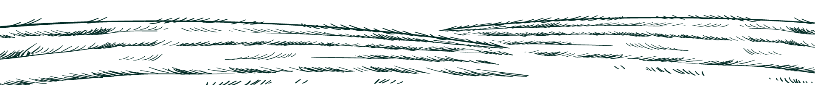
01.
ROVER

Slide 5



ROVER- FEATURES
SENSORS
MOVEMENT
The rover is fitted with sensors that help it sense and study its surroundings—it carries a DHT11 for reading air temperature and humidity, a soil moisture probe to check how wet the ground is, and an ESP32-CAM with an OV2640 camera for capturing real-time images. Their names might sound technical, but they simply let the rover feel the air, touch the soil, and see the world around it.
The rover moves using two DC motors controlled by a motordriver—one at the back for driving speed and another at the front for steering direction. It turns, rolls, and adjusts its path smoothly across the soil, guided by signals from the app over Bluetooth. Though its motion looks simple, every move is a balance of speed, direction, and control working together.

Slide 6

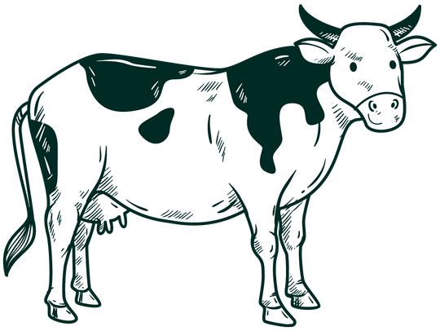
Explanation about rover
Sensor Unit
Motion Unit
Power Unit
The sensor unit is the rover’s sense of awareness—it reads the world around it through the DHT11, soil moisture probe, and the ESP32-CAM with its OV2640 camera. Together, they capture air conditions, soil health, and live visuals of the surroundings. These readings help farmers understand the field better and guide decisions with real data instead of guesswork.
The motion unit gives life to the rover, allowing it to move and explore its environment. It uses two DC motors connected to a L298N driver—one for forward or backward speed and the other for steering at the front. Through Bluetooth commands from the app, it drives with smooth control, adapting its movement to the terrain beneath its wheels.
The power unit is the heart of the rover, supplying the energy that keeps every part alive. It runs on rechargeable 18650 lithium-ion batteries that store enough power for both movement and sensing. A voltage regulator ensures stable current to the ESP32, camera, and motors, preventing sudden drops or surges. Without this steady source, the rover’s sensors would fail and its wheels would stop turning.

Slide 7
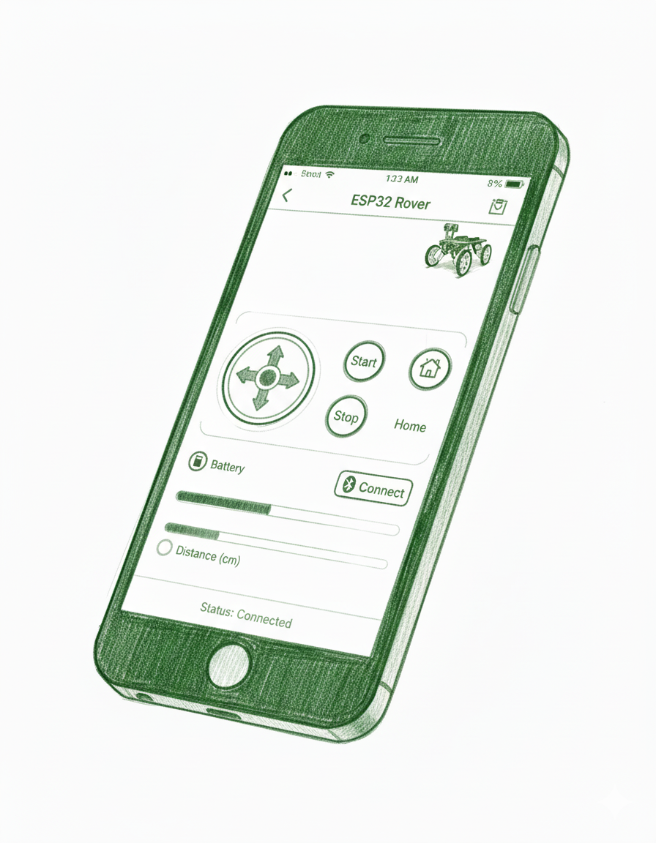
02.
application

Slide 8





Major Components of the application
Control Interface
Knowledge center
The control interface lets users drive and steer the rover through simple on-screen controls. Each tap or joystick move sends a Bluetooth command, making movement quick and precise.
The knowledge center shares details about seeds, crops, and farming methods. It connects to online sources to help farmers learn better planting and care practices.
Sensor dashboard
Data & settings hub
The sensor dashboard shows live data from the DHT11, soil probe, and camera. It gives a clear view of temperature, humidity, soil moisture, and field visuals in real time.
The data hub stores readings, preferences, and Bluetooth links. It keeps the app connected to the rover and ensures smooth data flow between both ends.

Slide 9
Can farmers adapt with tech?

Slide 10
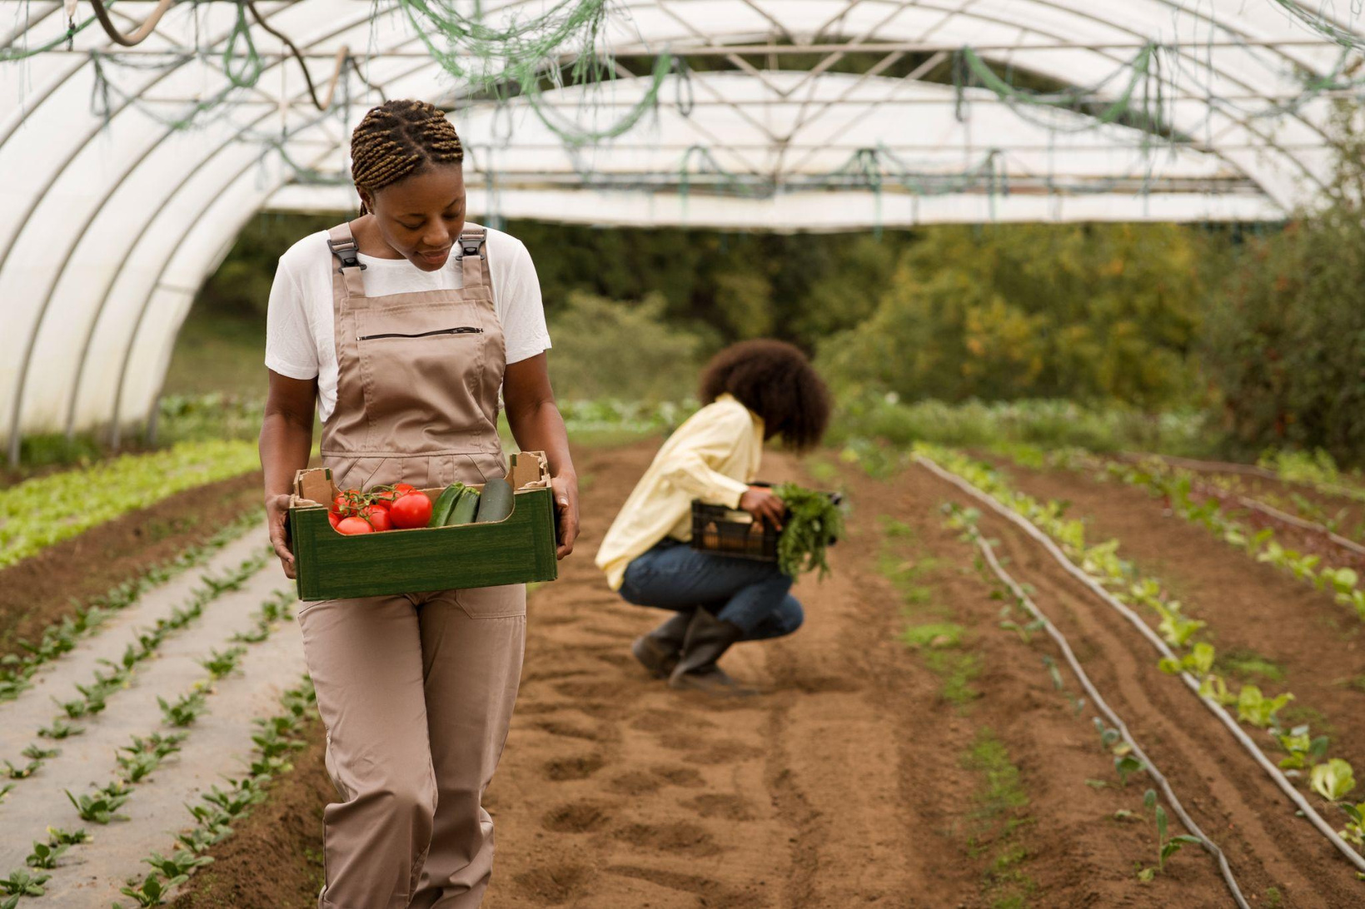
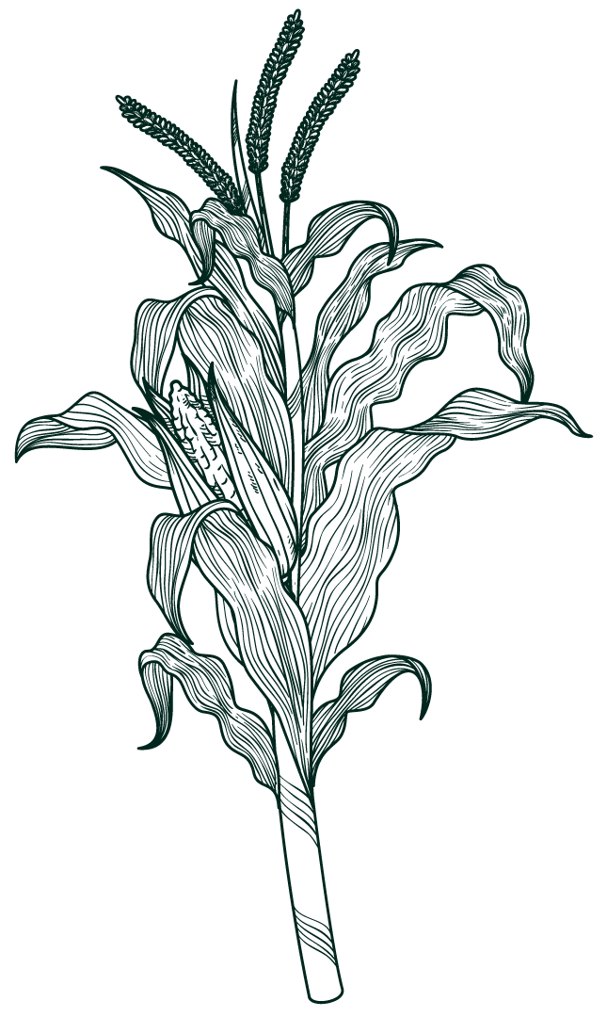
Around 90m
Farmer are in India
85%
Of them have smartphones.
86%
Of total farmers don’t have knowledge of better farming practices like organic farming

Slide 11

TEAM MEMBERS
Mohit Pujari
Madhav Dass
Shlok Mhatre
Janhavi Junghare
Zeba Ansari

Slide 12
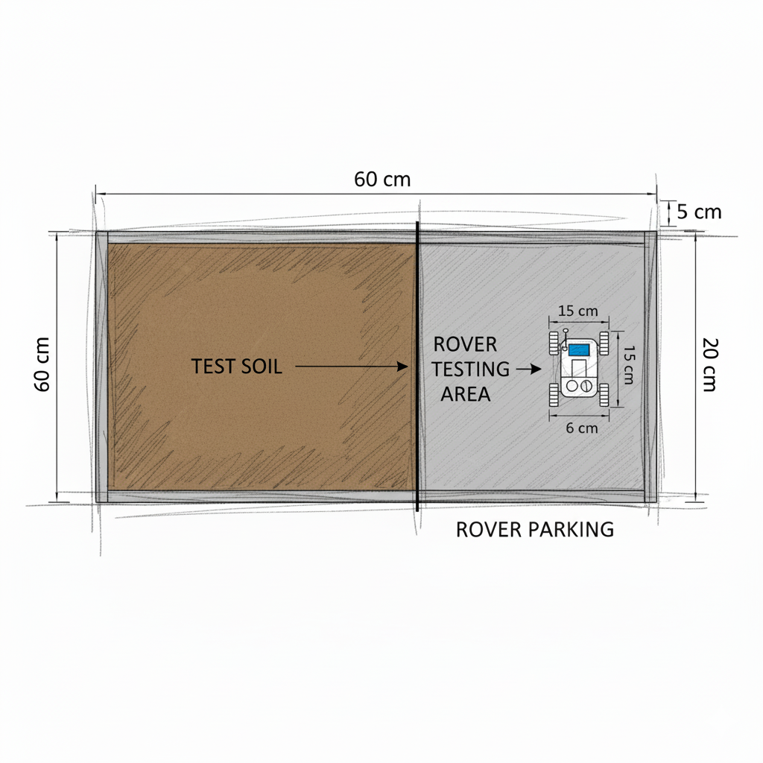


PROTOTYPING LANDSCAPE
The prototyping landscape is a small testing area built to simulate real farm conditions. It measures about 60 cm by 20 cm and includes soil, small plants, and uneven surfaces to mimic natural terrain. The rover moves across this space to test its sensors, wheels, and steering system in realistic conditions. It helps observe how the rover reads soil moisture, captures images, and responds to different surfaces before being used in larger farm fields.

